Slide 1

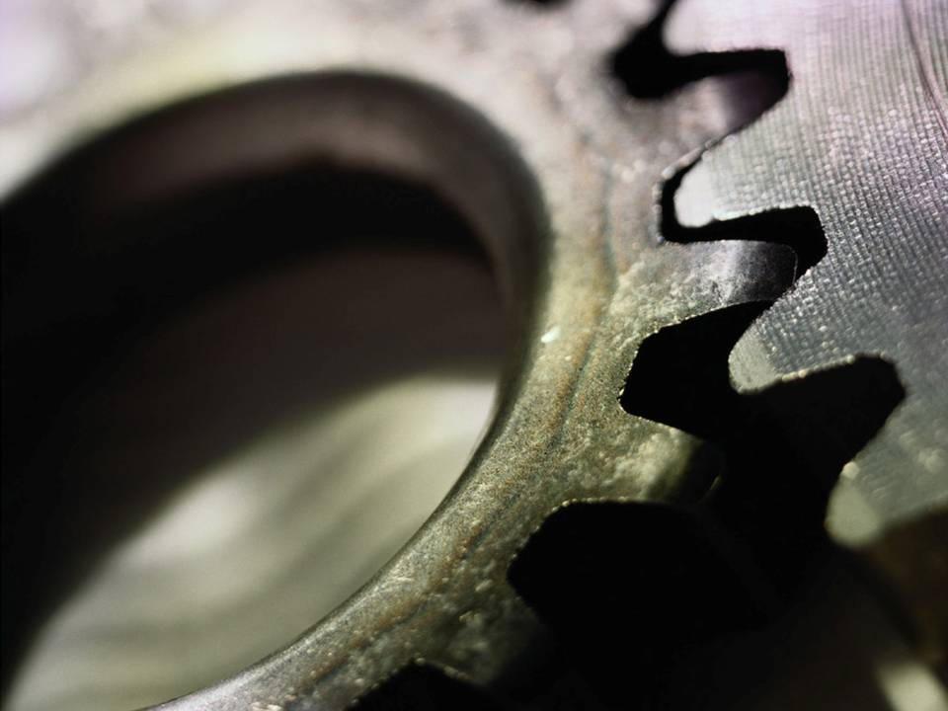
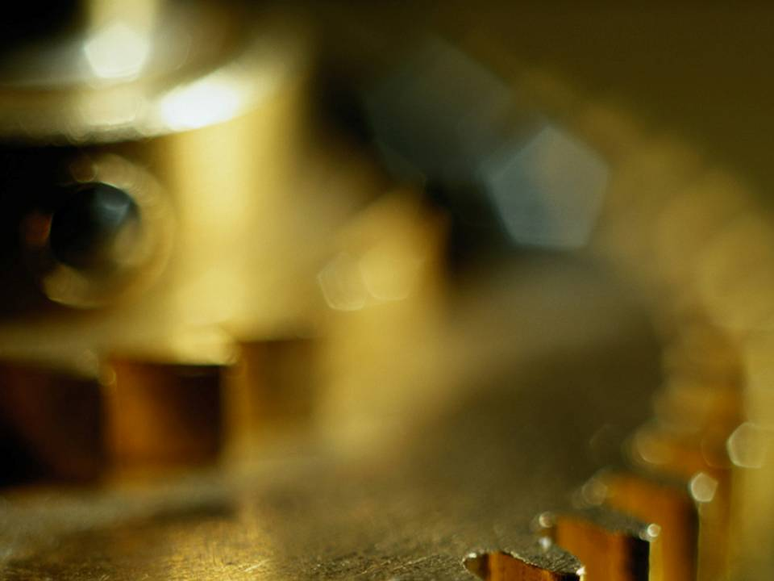
Chapter 8
Convention Practice
in Orthographic Writing

Slide 2
TOPICS
Definition
Purposes
Types of conventions
- Alternate position of side view
- Incompleted view
- Aligned view
- Enlarged view
- Non-existing intersection line
- Cylinder intersection

Slide 3
DEFINITION
Convention is a commonly accepted practices which disregard some strict rules of orthographic projection.
More readable
multiview
representation
Multiview
representation
Object
Projection’ s
rules
Disregard
some rules
Convention
practices

Slide 4
EXAMPLE : Already met convention practice
Front view
Using a dash line for representing the hidden edge.
CONVENTION
PRACTICE

Slide 5
PURPOSES
To improve the clarity of a drawing.
To facilitate the dimensioning.
To reduce the drafting effort.
To save or efficiently use a drawing
space.

Slide 6
TYPES OF
CONVENTION PRACTICE
1. Alternate position of side view
2. Incompleted view
2.1 Incompleted side view
2.2 Partial view
2.3 Half view
2.4 Local view

Slide 7
TYPES OF
CONVENTION PRACTICE
3. Aligned view
4. Enlarged view
5. Non-existing intersection line
6. Intersection : Hole on a cylinder

Slide 8
ALTERNATE POSITION OF
SIDE VIEW

Slide 9
ALTERNATE POSITION OF SIDE VIEW
Purposes
To save drawing space.
To improve the clarity of a drawing.
Conventional practice
Whenever the height of an object is small and the
depth is relatively large, places the side view beside
the top view.

Slide 10
Example
Top
Front
Right

Slide 11
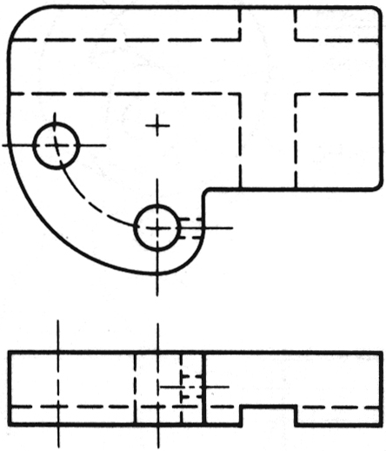
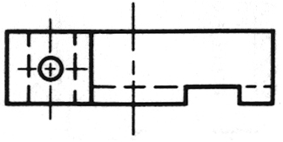
Example
New orientation of views still
agree with 3rd angle system.
Slot becomes
more readable.
Hole becomes
more readable.

Slide 12
INCOMPLETED SIDE VIEW

Slide 13
DEFINITION
Incompleted side views are side views that
are eliminated a feature that can not clearly
seen from a selected viewing direction.

Slide 14
Example : Strictly orthographic projection.
Left-side view
Principal view
Right-side view
Details are interfered by those
on the opposite view.
Difficult to read and to dimension.

Slide 15
Example : Incompleted side views
Incompleted
left-side view
Incompleted
right-side view
Principal view
Better describe an object and
facilitate dimensioning.

Slide 16
Example : Incompleted side views representation
Principal view

Slide 17
PARTIAL VIEW
HALF VIEW
LOCAL VIEW

Slide 18
DEFINITION
Partial view is a view that represents portions
of the part that have a features need to clarify.
Half view is a partial view that is illustrated only half of the part.
Local view is a view that shows only features
need to clarify.

Slide 19
Example : Partial views
Clearly seen
a shape.

Slide 20
Example : Half view
Left half
Right half
Center line acts as a
line of symmetry.
No continuous line !
Symmetry symbol
Thin line (4H)

Slide 21
Example : Half view : alternative representation
Half view can be made by drawing the views
slightly beyond the line of symmetry.
No symmetry symbol.
It is allow for writing
a break line.
Thin line (4H)
In this course, we omit the break line.

Slide 22
Example : Half view : two symmetry axes

Slide 23
Example : Local view
Shape of the
slot is completely
shown.
7
Easy for
dimensioning
R6

Slide 24
ALIGNED VIEW

Slide 25
DEFINITION
Align view is a view that is drawn by imaginarily
rotating the object’s features, appeared in a
principle view about symmetry axis.

Slide 26
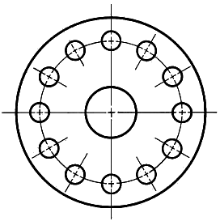


Example : Necessity of align view
Strictly Projection
Apply convention
Confuse
Clear
Waste of time

Slide 27
CONVENTION PRACTICE
For an object that has symmetrical positioned
features, it is advisable to show them on adjacent
view in true size at true radial distance from
the symmetry axis.

Slide 28
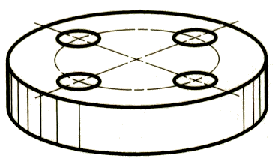
Example : Align view of holes
Given
Apply
aligned
convention
Gives the impression that there
is a hole at the center of the plate.

Slide 29
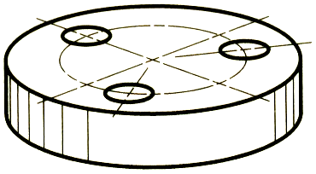
Example : Align view of holes
Given
Apply
aligned
convention
Gives the impression that holes
are at unsymmetrical position.

Slide 30
Example : Align view of holes
Apply
aligned
convention

Slide 31
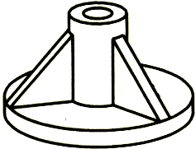
Example : Align view of ribs
Example :
Apply
aligned
convention

Slide 32
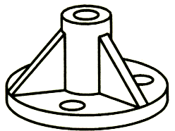
Example : Align view of ribs & holes
Apply
aligned
convention

Slide 33
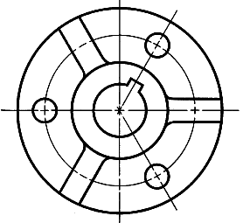
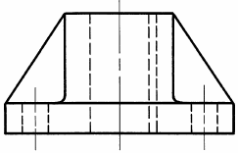
Example : Align view of ribs & holes & keyway
Make Orthographic Projection
Apply Convention

Slide 34
Example : Align view

Slide 35
ENLARGED VIEW

Slide 36
DEFINITION
Enlarged view is a view partly selected from
full view and is drawn with a larger scale.
Conventional practice
At full view, the selected portion is framed by
continuous thin line and having a name.
For an enlarged view, it must be specified both
name and scale used.

Slide 37
Example : Enlarged view
Full view
Enlarged view
or
A
A (3:1)
A (3:1)
Reference
position
Scale

Slide 38
NON-EXISTING LINE OF INTERSECTION

Slide 39
DEFINITION
Non-existing line of intersection is the line of
intersecting surfaces that are eliminated by fillets
and rounds.
Conventional practice
When true projection mislead the representation
of an object, it is necessary to show the additional
lines that are projected from the actual intersection
of the surfaces as if the fillets and rounds were
not present.

Slide 40
Example : Non-existing line of intersection
Object does not has
rounds and fillets
Edges of the surfaces
are shown as lines in
the top view.

Slide 41
Example : Non-existing line of intersection
Object has
rounds and fillets
The view looks like a plate
with a hole !!
Convention practice required !
Construct a non-existing line of intersection.
No edge !
(No intersection between surfaces)

Slide 42
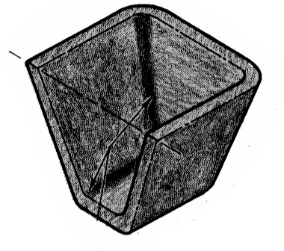
Example : Non-existing line of intersection

Slide 43
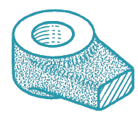
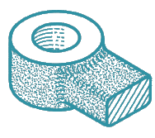
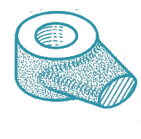
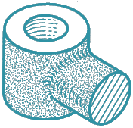
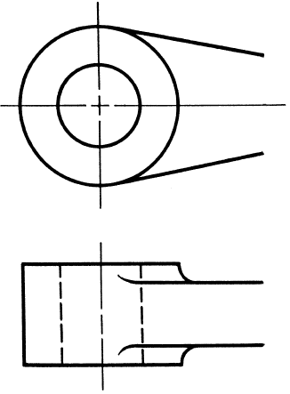
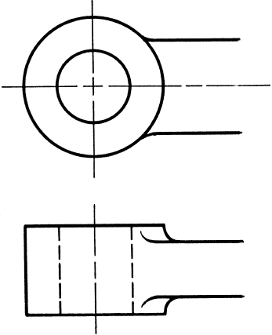
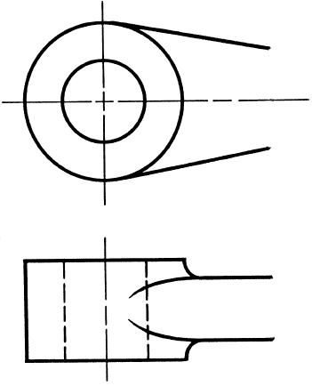
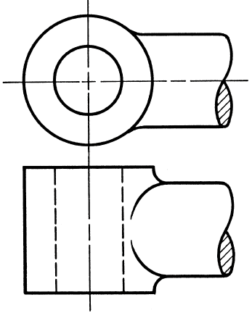
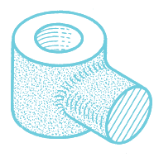
INTERSECTION BETWEEN
FILLET AND ROUND
Runout

Slide 44
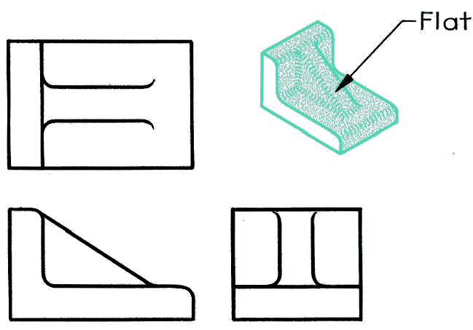
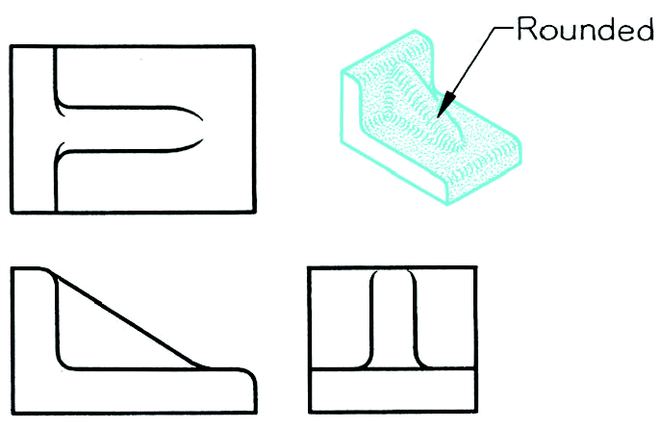
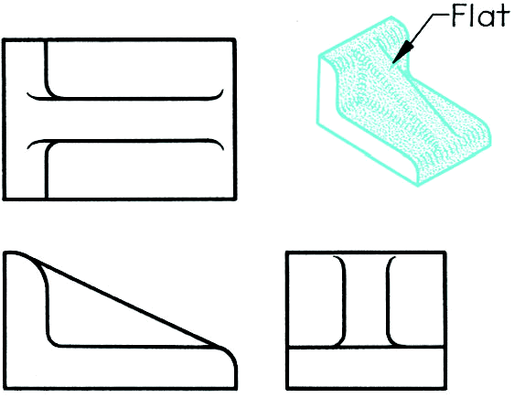
INTERSECTION BETWEEN
FILLET AND ROUND

Slide 45
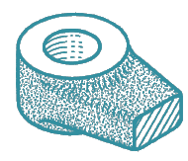
TO DRAW A RUNOUT
R
R
R/3
Tangent point
about 1/8 of circle
R = radius of fillet or round

Slide 46
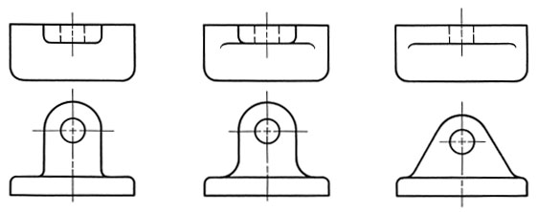
INTERSECTION BETWEEN
ROUND PLANE SURFACE

Slide 47
INTERSECTION

Slide 48
HOLE IN CYLINDER
Large hole : True projection

Slide 49
HOLE IN CYLINDER
Large hole : True projection
Small hole : Convention

